Slide 1

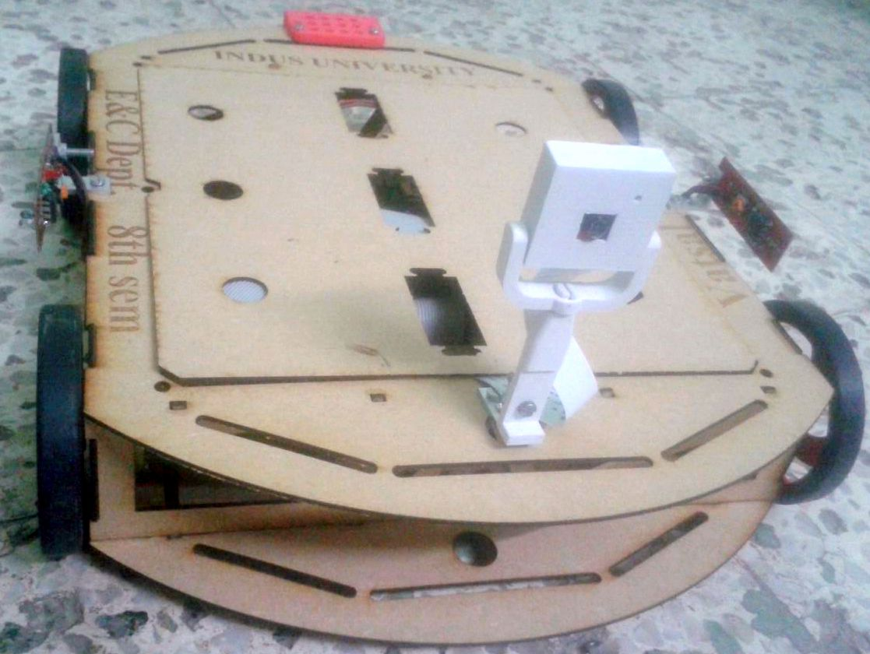
MAJOR Project Presentation on IOT ROBOT
VATSAL N SHAH
IU1241090055
Department of Electronics & Communication Engineering
Indus Institute of Technology and Engineering

Slide 2
Abstract
The Purpose Of This Project Is To Control Robot With An Interface Board Of The Raspberry Pi, Sensors And Software To Full Fill Real Time Requirement.
Controlling DC Motors, Different Sensors, Camera Interfacing With Raspberry Pi Using Gpio Pins.
Live Streaming, Command The Robot Easily, Sends Data Of Different Sensors Which Works Automatically Or Control From Anywhere At Any Time.
Design Of The Website And Control Page Of Robot Is Done Using Java Tools And Html. This System Works On IOT Concept.
This Will Enable Raspberry Pi To Be Used For More Robotic Applications And Cut Down The Cost For Building An IOT Robot.

Slide 3
Introduction
Background/Motivation:
Raspberry Pi Is A Credit-card Sized Computer.
The Research And Development Of Raspberry Pi Controlled IOT Based Robot.
IOT Is Internet Of Thing Where All The Physical Devices Connects With Digital Systems, Such As Refrigerator, TV, Ac, Washing Machine, Music System Which Can Works Automatically Or Control From Anywhere.
Researched Says 50 Billions Devices Will Connect By 2020.
It Is Connected With The Internet And Robot Can Be Controlled As Per Given Command.
Technology:
The Technologies Used In The Project Are Java, HTML, Java Script, JSP, Ajex, JSP & Servlet.
It Uses The Wireless Technology To Communication Between Raspberry Pi And User Interface.

Slide 4
Objective
To develop an IOT technology based robot, which can be controlled by a mobile devices/ computer over the Internet / Wi-Fi from anywhere at any time.
Gather system requirements
Evaluate and study the platform required for the system
Evaluate and study suitable development language, technologies and tools
Evaluate Methods of Interface
Program Raspberry Pi
Interface board for dc motors
Program Website & Control Page
Evaluate and test the system
Maintain system

Slide 5
Design Methodology
The design consists more on actual planning of hardware part than the code to be created. A number of software and hardware implementation techniques were used to design and develop the system. Fig. 1 shows the block diagram of system.
This section can be divided into many parts: Raspberry pi controller, Wifi dongle, Camera design, Power supply adapter, Ultrasonic sensor, IR sensors, and Motor control design.

Slide 6


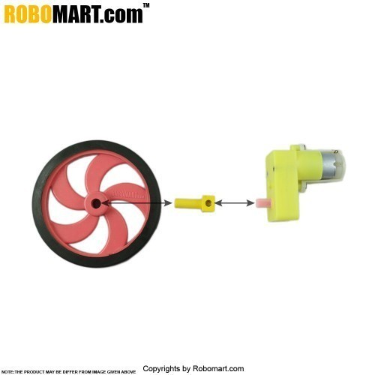
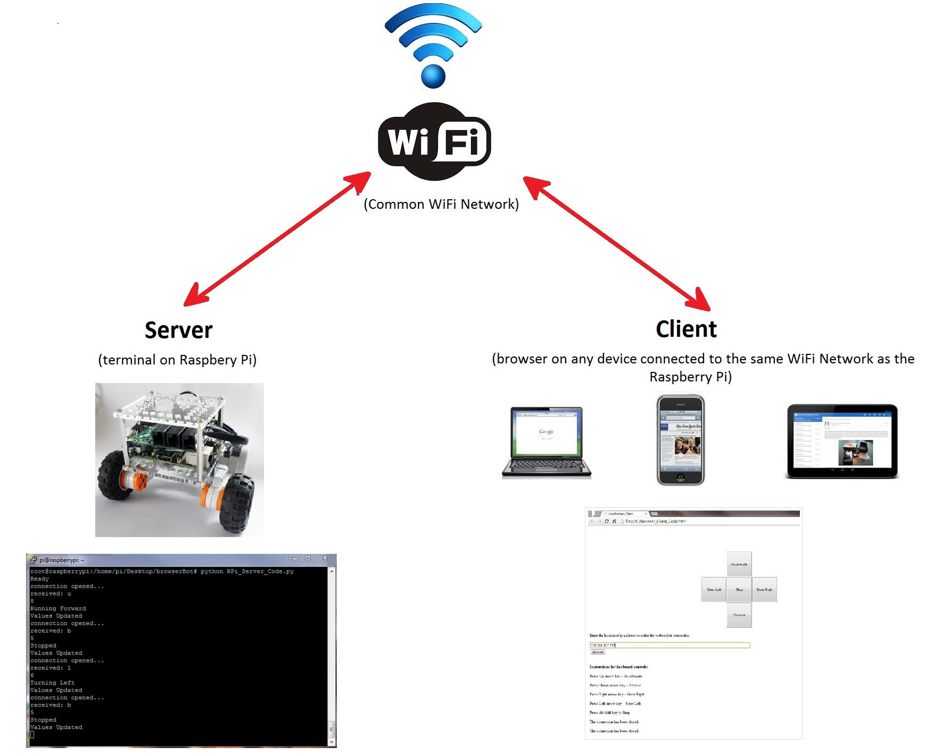
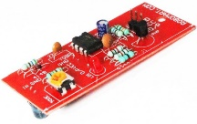
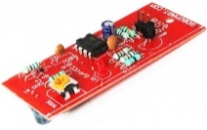
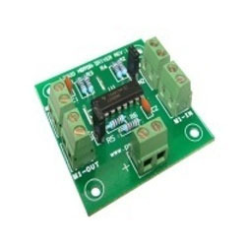
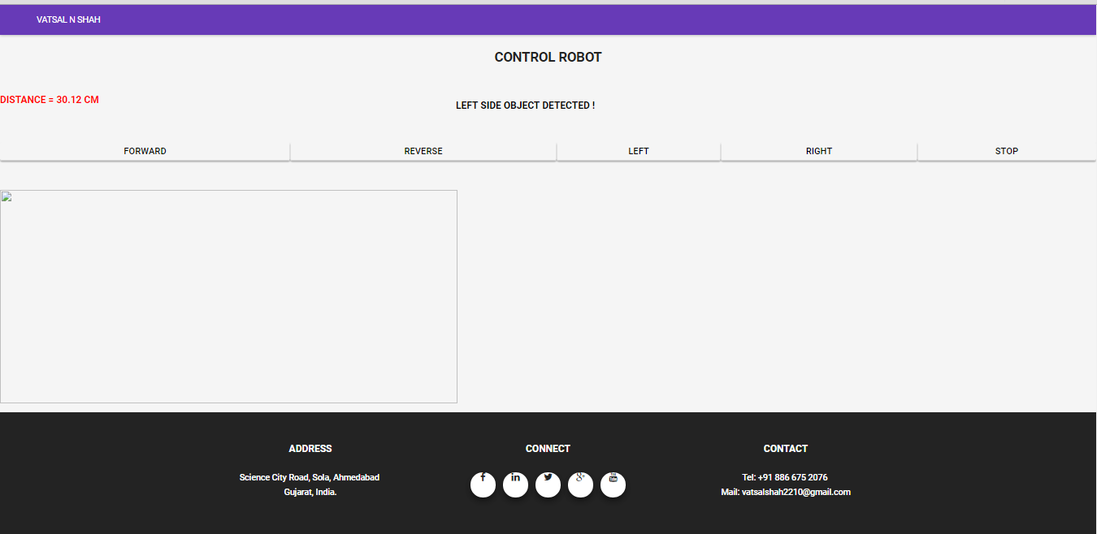
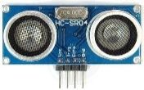
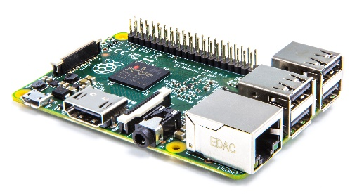
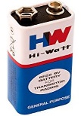
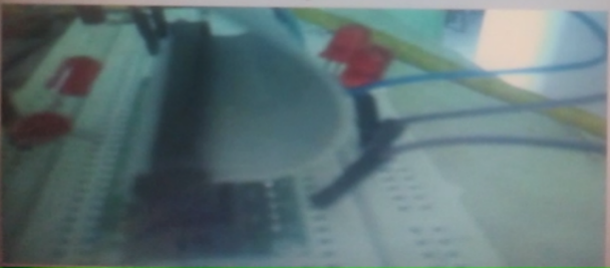
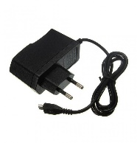
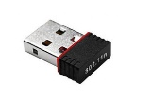
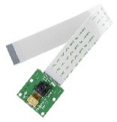
Block Diagram
No. | Item | No | Item
1 | Raspberry Pi 2 | 7 | Left Side DC Motor
2 | Wifi Dongle | 8 | Right Side DC Motor
3 | Raspberry Pi Camera | 9 | L293D Motor Driver Board
4 | 5V Adapter | 10 | 9V Battery
5 | Ultrasonic Sensor | 11 | Control from different devices
6 | IR Sensors | 12 | User Interface to Control Robot
Server
(Raspberry Pi)
Client
(browser on any device connected to the same WiFi network as the Raspberry Pi)
7
8
11
6
12
9
5
10
1
4
3
2

Slide 7
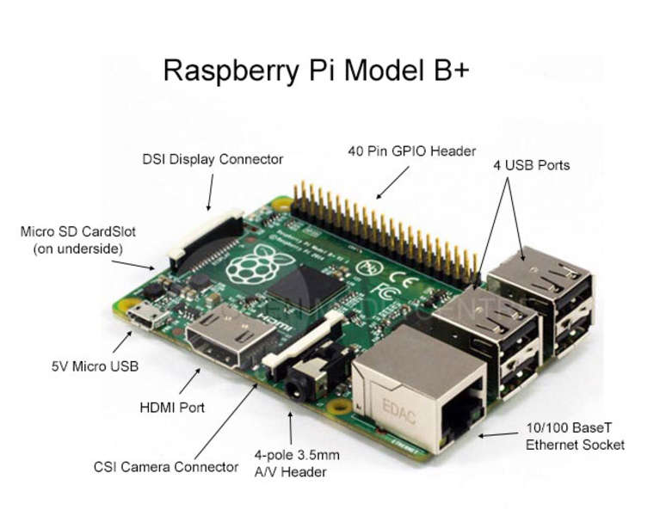
Components Details
Raspberry pi 2:
The Micro SD card is used for installing OS and the complete project will be done with python coding.
The board has specification:
A 900MHz quad-core ARM Cortex-A7 CPU | 4 USB ports
1GB RAM | Full HDMI port
40 GPIO pins | Display Interface
Ethernet Port | Micro SD card Slot
Combined 3.5mm audio jack and composite video | Video core IV 3D graphics core
Camera Interface

Slide 8


Continue…
2. WiFi Dongle
Its 150Mbps Nano USB adapter. Wireless-N USB adapter is used to connect Raspberry Pi with Internet. Standards are IEEE 802.11n, 802.11g, 802.11b and frequency range is 2.4 GHz.
Support the systems as XP, Vista, WIN 7, WIN 8, and Linux.
3. Raspberry Pi Camera
The Raspberry Pi camera board contains a 5 MPixel sensor, and connects via a ribbon cable to the CSI connector on the Raspberry Pi.
In Raspbian support can be enabled by the installing or upgrading to the latest version of the OS and then running Raspi-config and selecting the camera option.

Slide 9
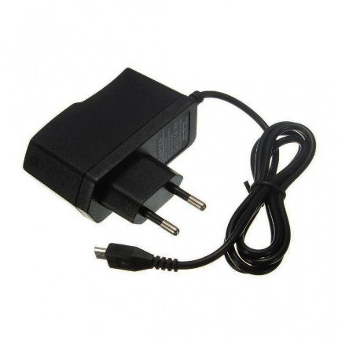
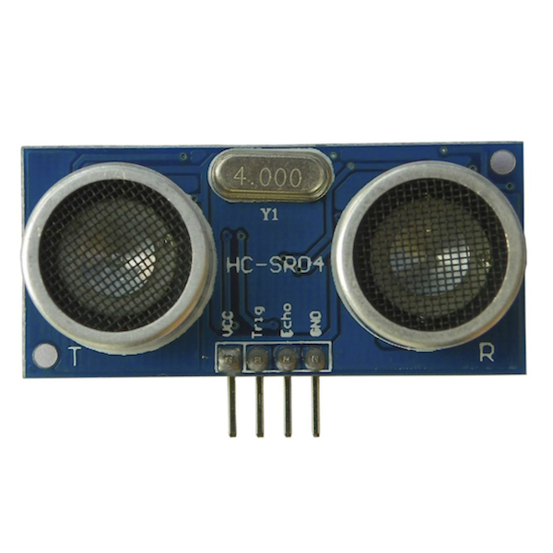
Continue…
4. 5V Adapter Power Supply
Raspberry Pi require power source to turn it on. 5V adapter Power supply is enough to power up. In project I connect Power bank with raspberry Pi, so that it can be put easily in structure.
5. Ultrasonic Sensor
This sensor is a high performance ultrasonic range finder.
It is compact and measures an amazingly wide range from 2cm to 4m.
This ranger is a perfect for any robotic application, or any other projects requiring accurate ranging information.

Slide 10
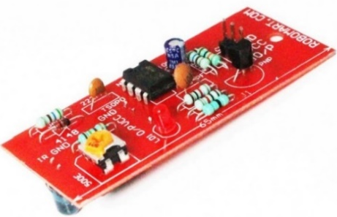
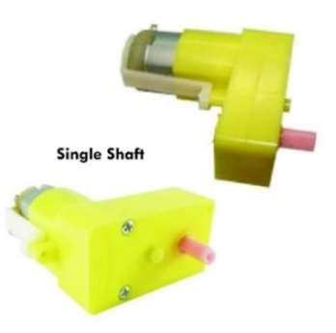
Continue…
IR Sensor
The sensor consists of two eyes.
One eye sends the infrared light and the other eye sees the reflection of that infrared light and measures the distance which is then sent to the Raspberry Pi to perform further operations based on the distance.
7. DC Motor
Almost every mechanical movement that we see around us is accomplished by an electric motor.
Electric machines are means of converting conventional energy. Motors take electrical energy and produce mechanical energy.

Slide 11
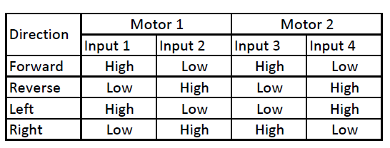
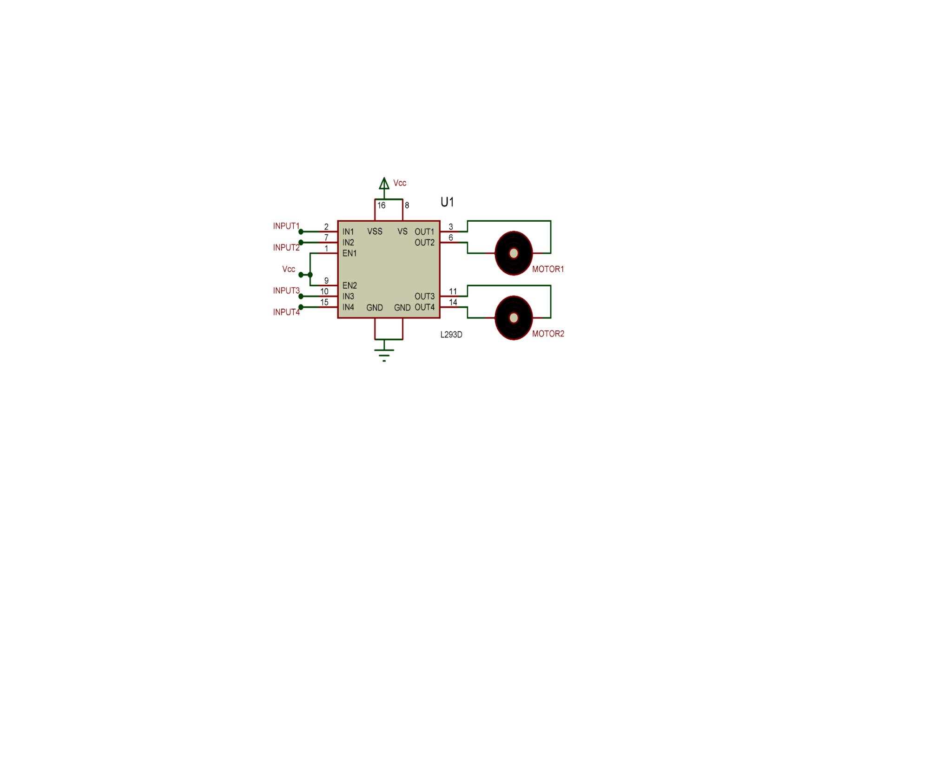
Continue…
8. L293D Motor Driver IC
A very easy and safe is to use popular L293D chip. It is a 16- pin chip.
The L293D is designed to provide bidirectional drive currents of up to 600-mA at voltages from 4.5 V to 36 V.
The dc motor and L293D IC has been connected according to the circuit schematic as shown has been designed using Proteus 7.

Slide 12
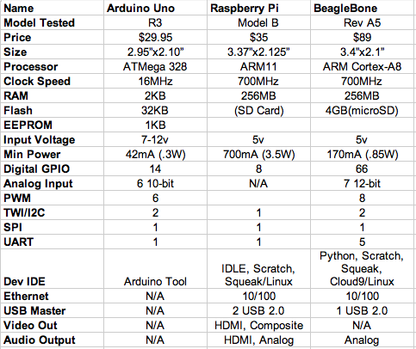
Comparison of Raspberry Pi other Competitor

Slide 13
Advantages of Raspberry Pi
This microcomputer is useful for small or home based businesses that run on a smaller budget than bigger companies for you are not required to purchase any special licenses from the Raspberry Pi Foundation to use their product or if you invent new technology that embeds the product.
The product does not require the user to have extensive programming experience since it is aimed for the younger generation to learn about programming. Python, the programming language that the Pi uses, is less complex than other languages available.
The SD cards on the board can be easily switched, which allows you to change the functions of the device without spending a lot of time re-installing the software.
The Raspberry Pi is perfect for adaptive technology: it is able to display images or play videos at 1080p high definition resolution. This product makes it possible to build complex and effective products at a cheaper price.

Slide 14
Disadvantages of Raspberry Pi
It does not replace your computer, since the Ethernet is only a 10/100 and the processor is not as fast, it is time consuming to download and install software and is unable to do any complex multitasking.
Not compatible with other operating systems such as Windows (There are currently 1.3 billion Windows users around the world.)
This product will not be useful for bigger businesses that already have big servers, which would already do everything that the Raspberry Pi does, so it would not be worth it to take the time to get someone to put it together.

Slide 15
















Tools Used

Slide 16
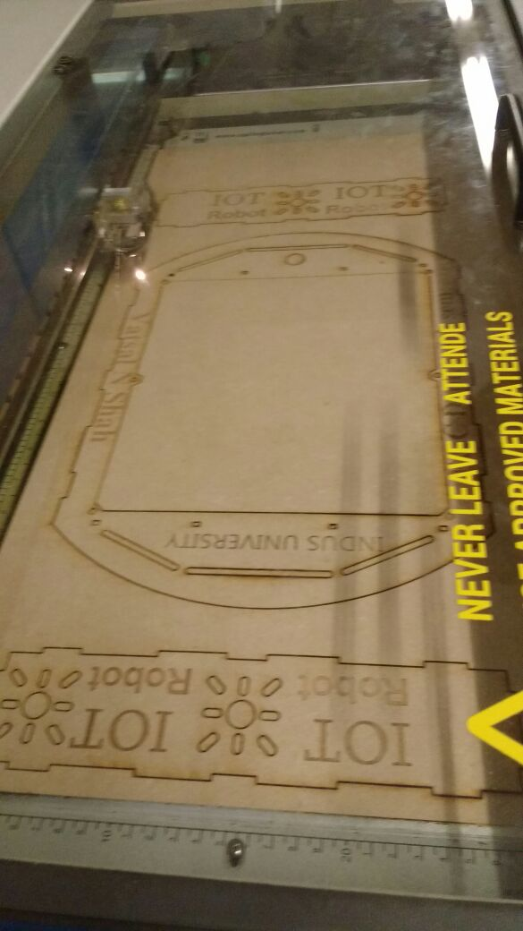
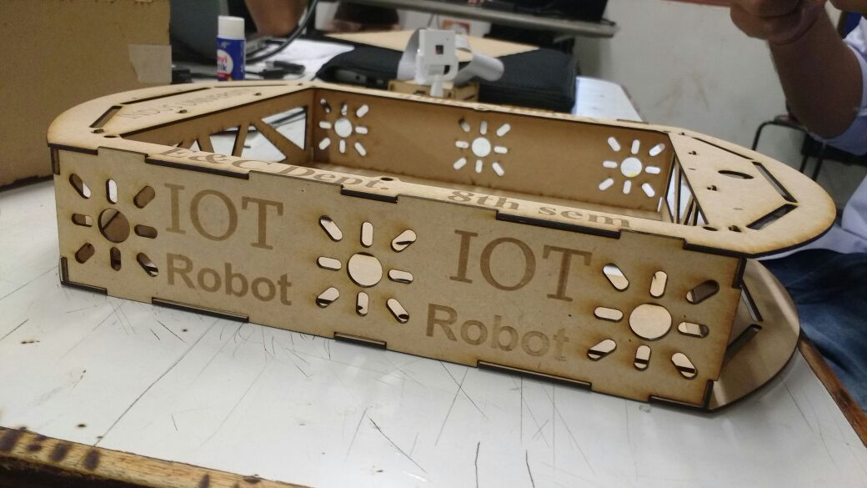
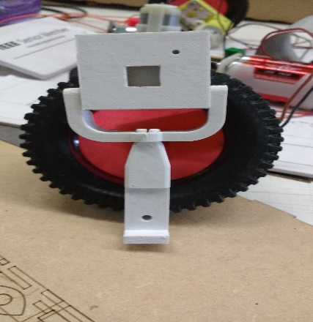
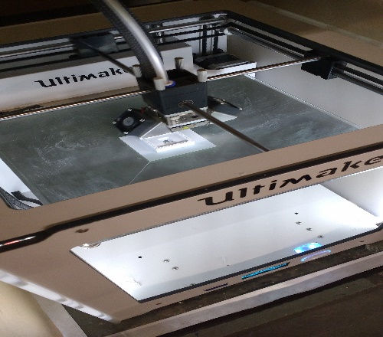
Implemented System
The system is implemented with Laser cutting tool and 3D printing tool.
Robot chassis is designed with Laser cutting and Ultrasonic sensor and Camera case is designed with 3D priming.
Using machine Ultimaker 2 case of Raspberry Pi camera is designed and working with it is shown below.
The full body requires time around 1 hours to print it.

Slide 17
Setup
Find IP address of Raspberry Pi in router
In MobaXteme software Enter the Raspberry Pi IP and Login
Run Shell script of Streaming and sensor program / run startup file
Deploy WAR file to Tomcat server on Raspberry Pi by using WinSCP
Enter URL in browser to open a website
Control the Robot by different options and view Live Streaming from page
Control Robot page can be opened from Mobile/Laptop/iPad
Goto My Project link, Register/Login using Email ID & password to open control Robot page
Flow Chart
The flow chart describe the necessary steps to execute once in the beginning, then when the Raspberry Pi turn on all the compilation files and video streaming file execute at its own using startup.sh file.

Slide 18

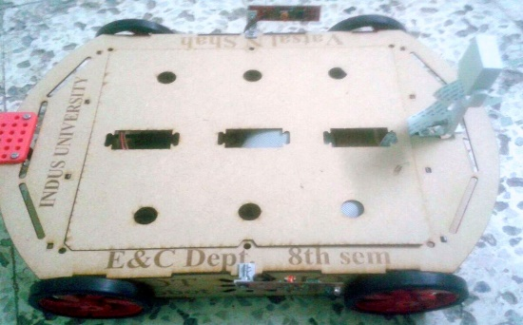
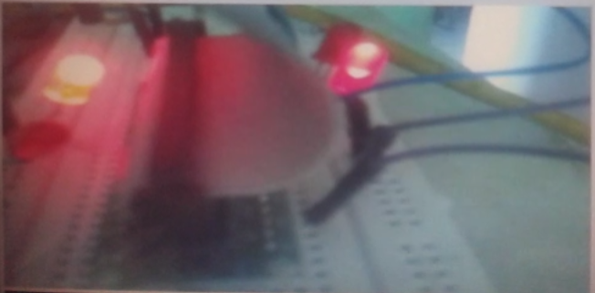
Results
No. | Test case description | Test Result
1 | Webcam Video display | Accepted
2 | Move Forward | Accepted
3 | Move Reverse | Accepted
4 | Turn Left | Accepted
5 | Turn Right | Accepted
6 | Stop | Accepted
7 | Ultrasonic sensor reading | Accepted
8 | IR Sensor reading | Accepted
7
8
2
3
4
5
6

Slide 19
Conclusion
During the course of the project I gained knowledge of Java I also gained knowledge of the Raspberry Pi technology and what the small computer is capable of.
After knowing the capabilities of raspberry pi and the applications it could have in the field of robotics, and IOT it actually has made me to think of doing more research work on the raspberry pi for the robotic and IOT applications.
The challenges that I faced during the course of the project were that of the time constrain, as I had to learn about the raspberry pi and then learn programming in Java and HTML.
Then during the programming of the server client interfaces the problems of calling functions with a button press.
One of the main challenges that No output comes when some functions are called from software side.
If given an opportunity to work again on the same technology i.e. the raspberry pi and IOT technology or on a project like this where the raspberry pi is used for any kind off application I would be happy to take it up.

Slide 20
Future Work
In the future this technology can be used in various different fields of work.
The robot can be made autonomous with the help of more sensor, gyroscope, compass and a GPS. So that it can be set to a target or a specific area where in can monitor.
Adding the Pneumatics design in Mechanical so robot can go up and down, can hold the object.
Face recognition: The robot will recognize the face images which are stored in controller and generate the alert if doesn't match.
By making above changes robot can do more functions as Open the door, Turn on/off switch, bring newspaper for user, etc.

Slide 21
References
Build and Interface Internet Mobile Robot using Raspberry Pi and Arduino by Prof. Dr. Nabeel Kadim Abid Al-Sahi, Innovative Systems Design and Engineering Vol.6, No.1, 2015.
Rasp-Pi based Remote Controlled Smart Advertising of Still and Moving Images, International Journal of Engineering and Computer Science, Volume 4 Issue 9, Sep 2015.
Design and build a Raspberry Pi robot By Stewart Watkiss, (PenguinTutor)
Cristina Turcu, Cornel Turcu, Vasile Gaitan, Merging The Internet Of Things And Robotics, Recent Researches In Circuits And Systems
Research Directions for the Internet of Things, John A. Stankovic, Life Fellow, IEEE
Early prototype of Raspberry Pi, http://www.raspberrypi.org/raspberry-pi-2006-edition/
Raspberry Pi Hardware information, http://elinux.org/RPi_Hardware
How SoC works, http://www.androidauthority.com/how-it-works-systems-on-a-chip-soc-93587/
Boot process, http://thekandyancode.wordpress.com/2013/09/21/how-the-raspberry-pi-boots-up/
JavaScript for webpage, https://www.codecademy.com/learn/javascript

Slide 22
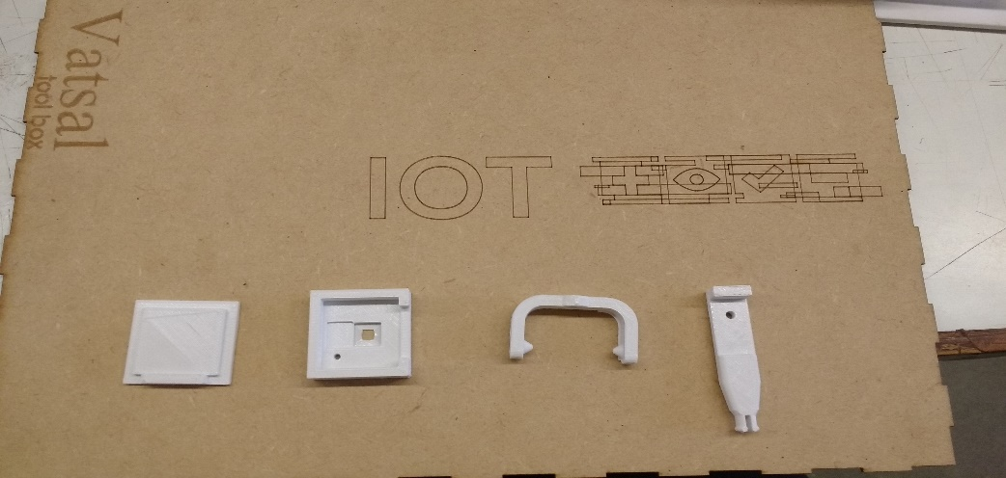
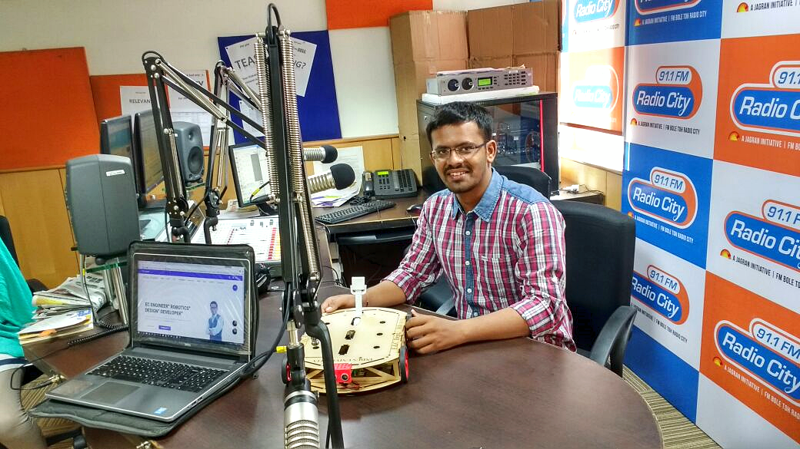
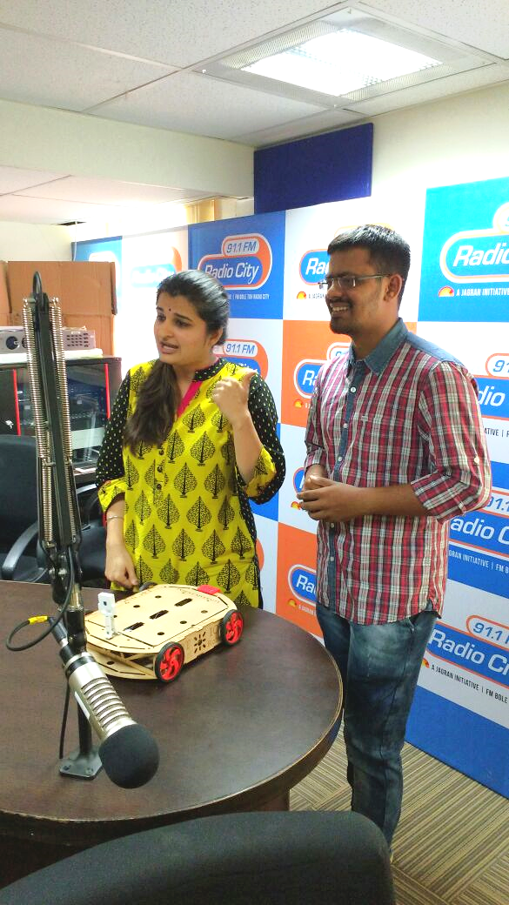
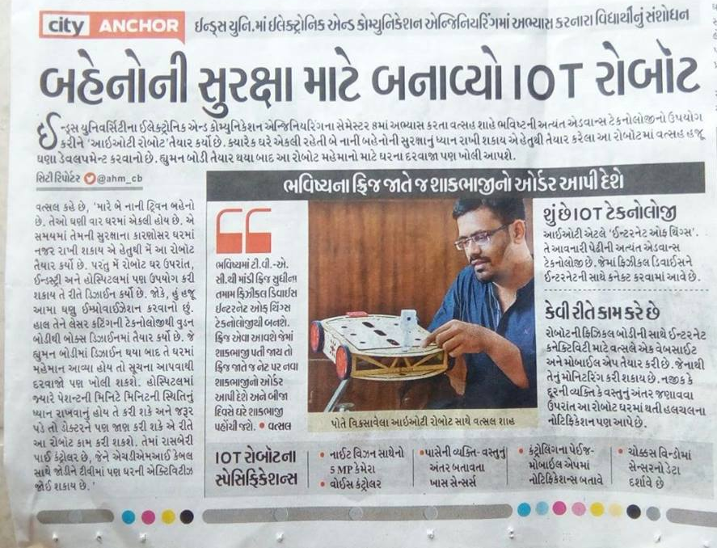
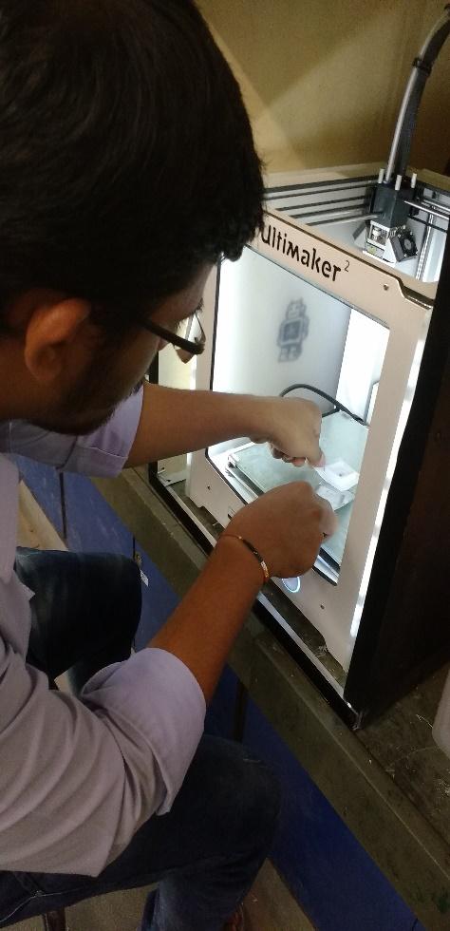
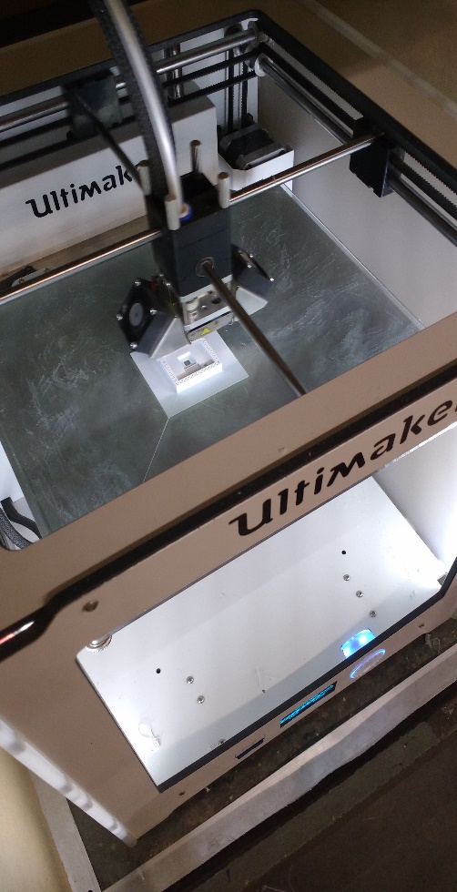
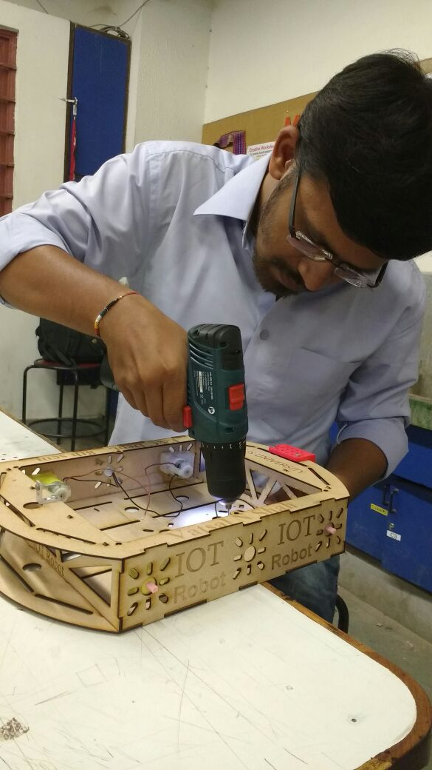

Slide 23


Slide 24
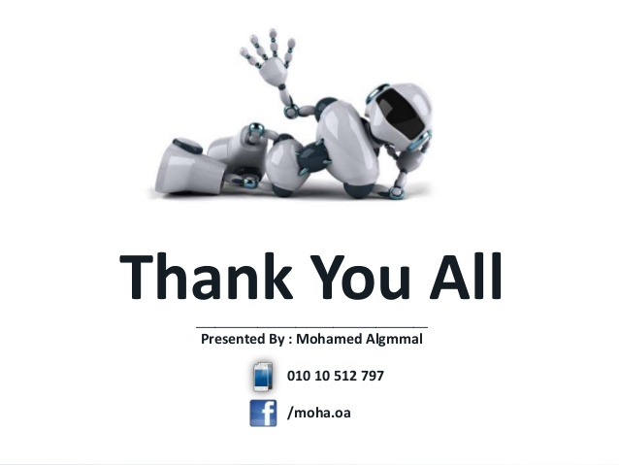
Presented By : VATSAL N SHAH
Facebook : /vatsalnshah4u
Email ID: vatsalshah2210@gmail.com

